Slide 1

Analyzing Covid-19 Tweets Dataset Using Apache Spark and Kafka
Khush Hardikkumar Jani - 40230516
Darshansinh Dilipsinh Devda - 40261713
Pranaykumar Rajeshkumar Chauhan - 40266722
Himanshu Rathod - 40234325
Adriana Danko - 40029681

Slide 2
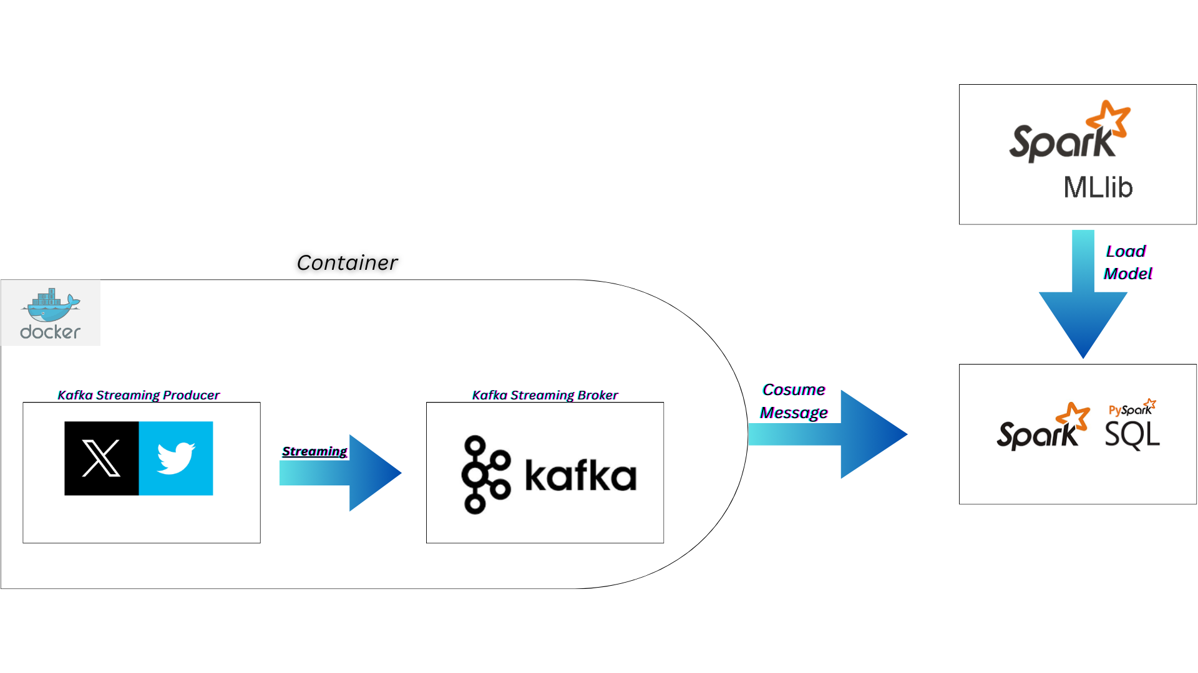
Distributed System Pipeline

Slide 3


Why?
Dockerized Kafka
Apache Spark
Durability
Data durability is ensured through replication of messages across multiple brokers.
Resilient Distributed Datasets (RDD)
Spark's fundamental data structure for distributed processing of data in parallel.
Dynamic Scaling
Fault Tolerance
Decentralization
Isolation
Topics and Partitions
Messages are organized into topics, and each topic is divided into partitions for parallel processing.
Cluster Computing
Scales horizontally by distributing tasks across a cluster of machines.
Spark SQL and DataFrames
Provides a SQL interface and DataFrame abstraction for working with structured data.
Publish-Subscribe Model
Kafka uses a publish-subscribe model for message distribution among multiple producers and consumers.
Parallel Processing
Fault Tolerance
Resource Management
Distributed Storage

Slide 4
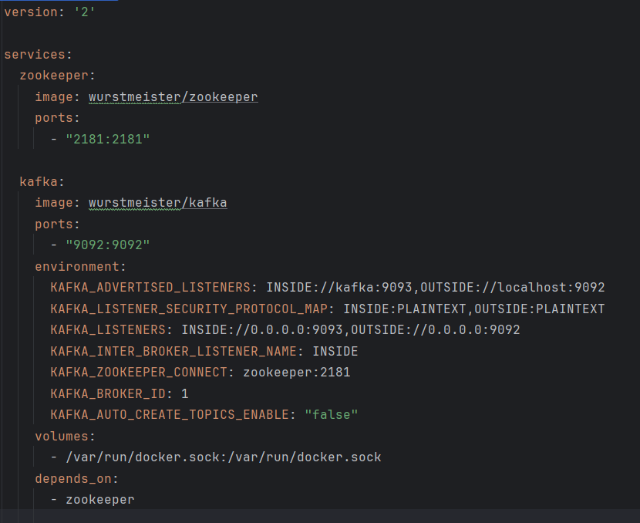
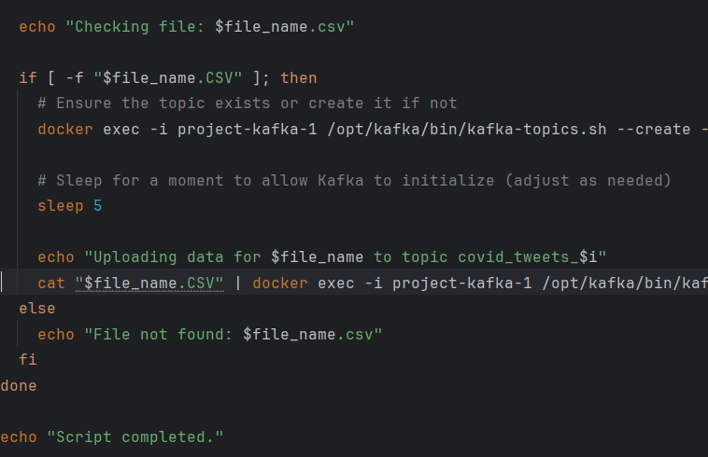
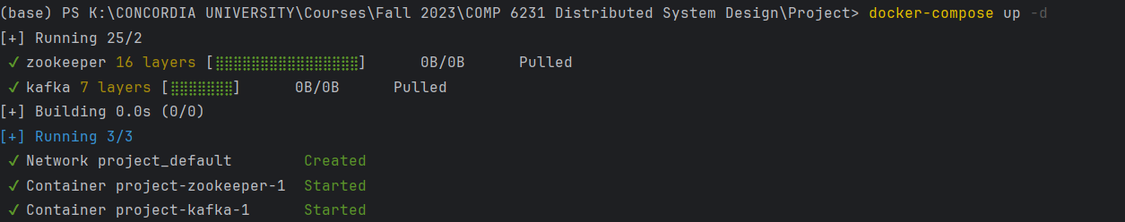
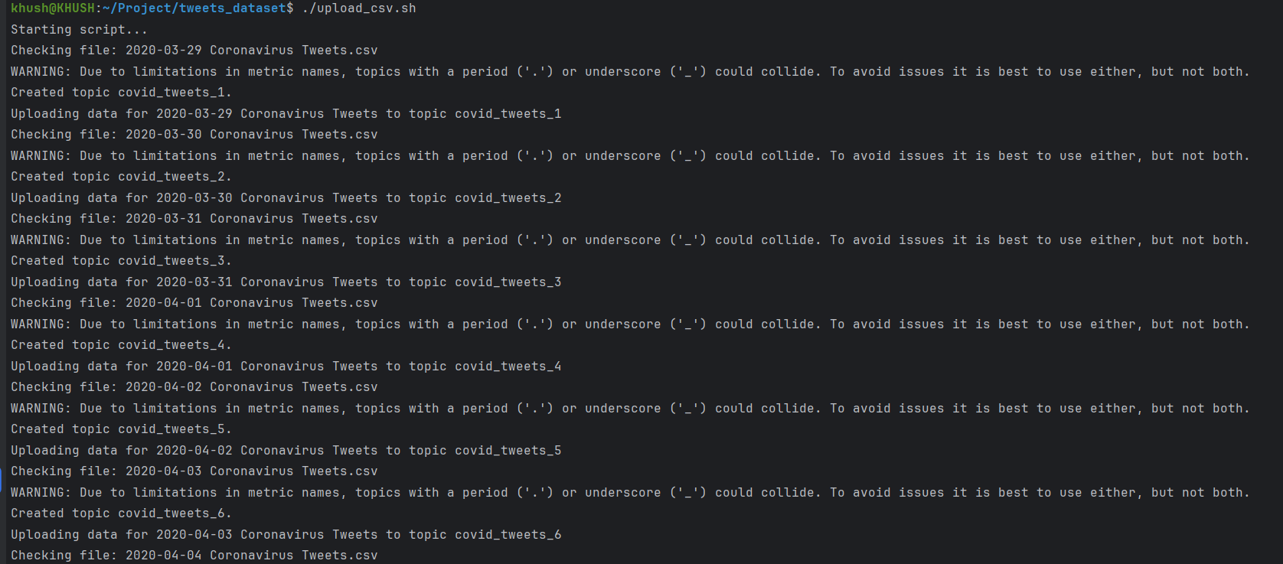
Docker-compose.yml
Upload_csv.sh

Slide 5
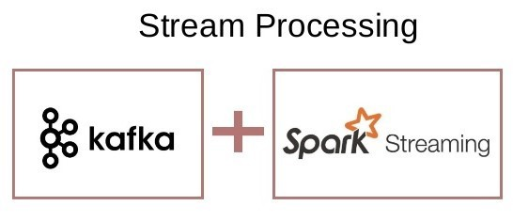
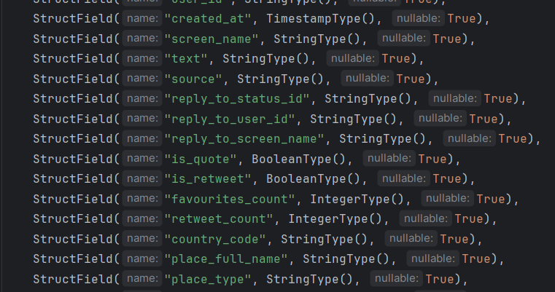
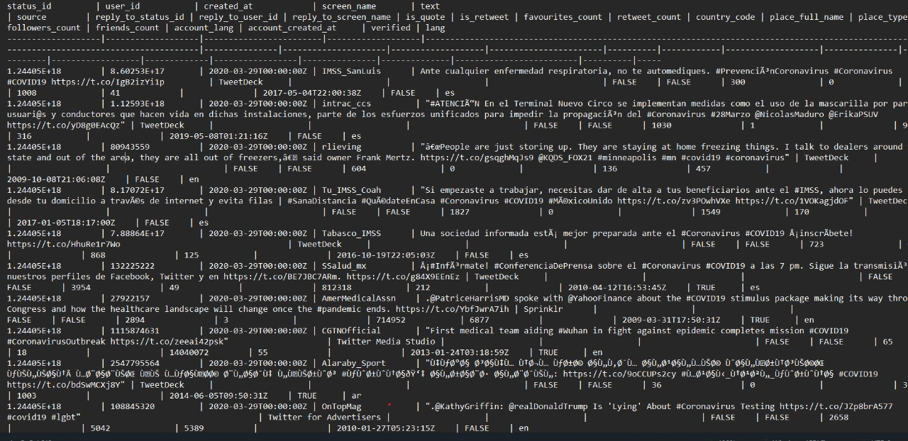
Kafka to Spark Integration

Slide 6
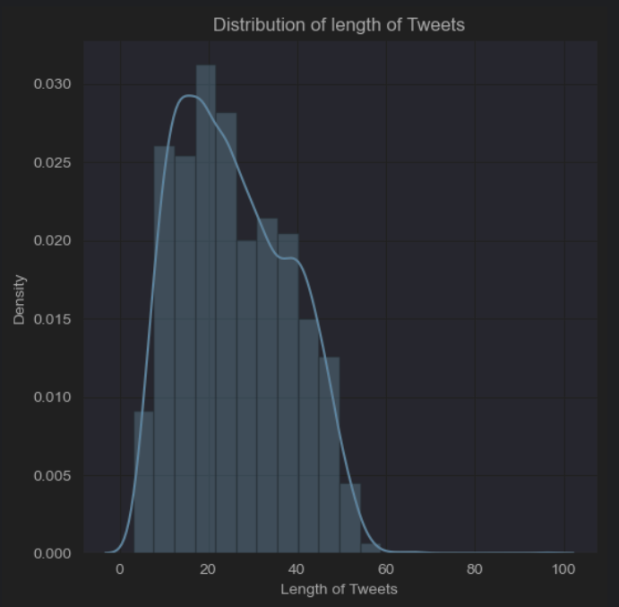
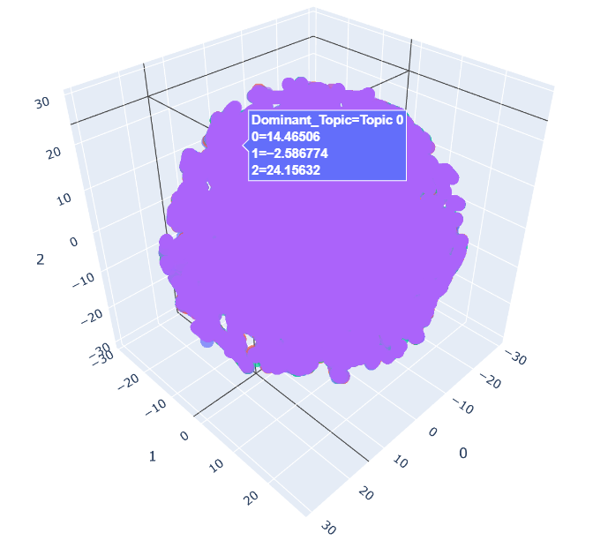
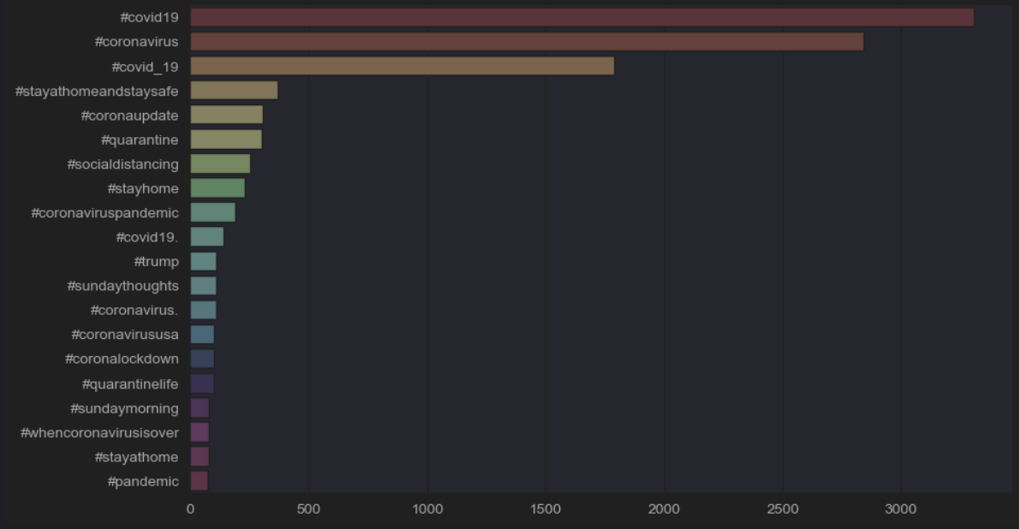

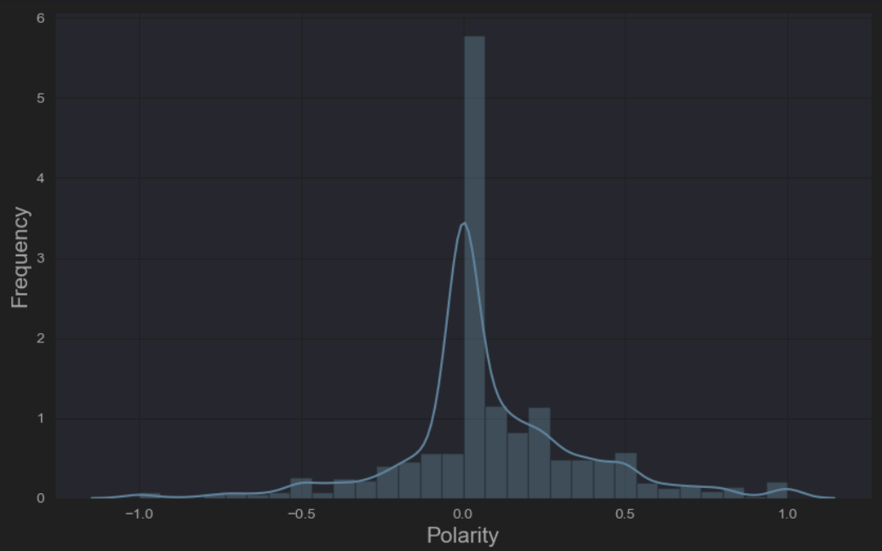

EDA and Statistical Analysis
Distribution of Tweet Lengths
3D t-SNE Plot
Top Hashtags Used
Unique Hashtags Stylecloud
Polarity Plot
Wordcloud

Slide 7
Limitations
Network Configuration and Communication Overhead.
Docker-Host Interaction
Dependency and Compatibility Issues
Integration Complexity and Management
Container Orchestration and Monitoring

Slide 8
Future Enhancements
Deploy spark within Docker container
Scalability
Resource Sharing
Fault Tolerance
Scaling multiple instances of kafka consumer
Increases resource sharing

Slide 9
THANK YOU

